Slide 1
Exam 1 Charges
Chapters 21, 22, 23

Slide 2
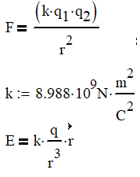
Ch 21: Electric Charge
Force between 2 charged particles
Electric field from a single charge

Slide 3
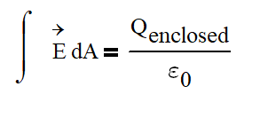
Ch 22 Gauss’ Law
Useful when working with distributed charges
ε₀ = 8.854×10⁻¹²

Slide 4
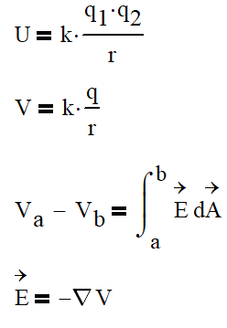
Ch 23 Energy with regards to Charges
Potential energy between 2 charged particles
Potential from a single charged particle
Relationship between voltage and electric field

